Slide 1
Model systems with interaction
Ising spin chain (with open boundary conditions)
Classical variable
$$S_{i}=±1$$
$$S_{n−1}$$
$$S_{n}$$
$$S_{n+1}$$
J
J
$$H=−\frac{1}{2}\sum_{i,j}{J_{ij}S_{i}S_{j}}$$
$J_{ij}$=$\left\{\begin{aligned}J for i,j nearest neighbors \\ \\ 0 otherwise\end{aligned}\right.$
$$H=−J\left(S_{1}S_{2}+S_{2}S_{3}+ …+S_{N−1}S_{N}\right)$$
$$Z=\sum_{α}{e^{−βE_{α}}}$$
$$=\sum_{S_{1},S_{2}, …,S_{N}}{e^{βJ\left(S_{1}S_{2}+S_{2}S_{3}+ …+S_{N−1}S_{N}\right)}}$$

Slide 2
$$Z=\sum_{S_{1},S_{2}, …,S_{N}}{e^{βJ\left(S_{1}S_{2}+S_{2}S_{3}+ …+S_{N−1}S_{N}\right)}}$$
$$=\sum_{S_{2}, …,S_{N}}{e^{βJ\left(S_{2}+S_{2}S_{3}+ …+S_{N−1}S_{N}\right)}+e^{βJ\left(−S_{2}+S_{2}S_{3}+ …+S_{N−1}S_{N}\right)}}$$
$$=\sum_{S_{3}, …,S_{N}}{\left(\begin{aligned}{ e}^{βJ\left(1+S_{3}+ …+S_{N−1}S_{N}\right)}+e^{βJ\left(−1+S_{3}+ …+S_{N−1}S_{N}\right)}+e^{βJ\left(−1−S_{3}+ …+S_{N−1}S_{N}\right)} \\ +e^{βJ\left(1−S_{3}+ …+S_{N−1}S_{N}\right)}\end{aligned}\right)}$$
$$=\sum_{S_{3}, …,S_{N}}{{(e}^{βJ }+e^{−βJ})({ e}^{βJ\left(S_{3}+ …+S_{N−1}S_{N}\right)}+{ e}^{βJ\left({−S}_{3}+ …+S_{N−1}S_{N}\right)}) }$$
$$=2cosh{βJ}\sum_{S_{3}, …,S_{N}}{({ e}^{βJ\left(S_{3}+S_{3}S_{4} …+S_{N−1}S_{N}\right)}+{ e}^{βJ\left({−S}_{3}{+S}_{3}S_{4}…+S_{N−1}S_{N}\right)}) }$$
$$=2cosh{βJ}\sum_{S_{4}, …,S_{N}}{\begin{aligned}({ e}^{βJ\left(1+S_{4} …+S_{N−1}S_{N}\right)}+{ e}^{βJ\left(−1+S_{4}…+S_{N−1}S_{N}\right)}+ \\ {\begin{aligned} \\ e\end{aligned}}^{βJ\left(−1−S_{4} …+S_{N−1}S_{N}\right)}+{ e}^{βJ\left(1−S_{4}…+S_{N−1}S_{N}\right)}) \end{aligned}}$$
$$=2cosh{βJ}\sum_{S_{4}, …,S_{N}}{{(e}^{βJ }+e^{−βJ})({ e}^{βJ\left(S_{4}+ …+S_{N−1}S_{N}\right)}+{ e}^{βJ\left({−S}_{4}+ …+S_{N−1}S_{N}\right)})}$$
$$={\left(2cosh{βJ }\right)}^{2}\sum_{S_{4}, …,S_{N}}{ ({ e}^{βJ\left(S_{4}+ …+S_{N−1}S_{N}\right)}+{ e}^{βJ\left({−S}_{4}+ …+S_{N−1}S_{N}\right)})}$$

Slide 3
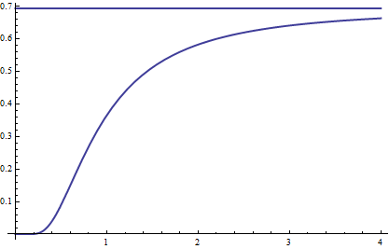
$$Z={\left(2cosh{βJ }\right)}^{2}\sum_{S_{4}, …,S_{N}}{ ({ e}^{βJ\left(S_{4}+ …+S_{N−1}S_{N}\right)}+{ e}^{βJ\left({−S}_{4}+ …+S_{N−1}S_{N}\right)})}$$
$$Z={\left(2cosh{βJ }\right)}^{N−2}\sum_{S_{N} }{ \left({ e}^{βJS_{N}}+{ e}^{−βJS_{N}}\right)}={\left(2cosh{βJ }\right)}^{N−2}\sum_{S_{N} }{2\cosh{βJS_{N}}={\left(2cosh{βJ }\right)}^{N−2}\sum_{S_{N} }{2\cosh{βJ}}}$$
$$Z=2{\left(2cosh{βJ }\right)}^{N−1}$$
$$G=−k_{B}T\ln{2}−k_{B}T\left(N−1\right)\ln{2cosh{βJ }}$$
$$g={\frac{G}{N}}_{ N→∞}=−k_{B}T\ln{2cosh{βJ }}$$
Entropy per spin:
$$s={\frac{S}{N}}_{ }=−{\left(\frac{∂g}{∂T}\right)}_{}=k_{B}\ln{2cosh{βJ }}−k_{B}T \frac{2\sinh{βJ}}{2cosh{βJ }}\frac{J}{k_{B}T^{2}}$$
$$\ln{2}$$
$$\frac{s}{k_{B}}$$
s$=k_{B}\ln{2cosh{βJ }}−\frac{J}{T} tanh{βJ}$
For
$$\frac{J}{k_{B}}=1 K$$
1
T->$∞ , β→0$
s$=k_{B}\ln{2}$
$$T$$
2
T->$0 , β→∞$
s${≈k}_{B}\ln{e^{βJ}{ }}−\frac{J}{T}=0$

Slide 4
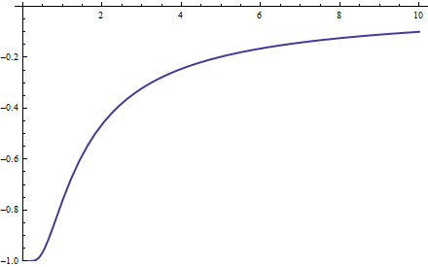
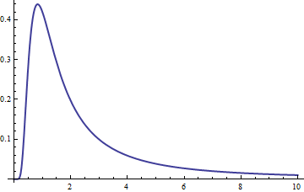
Internal energy per spin:
We recall from thermodynamics $U=G+TS+μ_{0}VMH$
which reduces for H=0 to
$$U=G+TS$$
$$u=\frac{U}{N}=g+Ts$$
$$=−k_{B}T\ln{2cosh{βJ }}+k_{B}T\ln{2cosh{βJ }}−\text{J} tanh{βJ}$$
$$T$$
$$u=−\text{J} tanh{βJ}$$
1
T->$∞ , β→0$
$u$=0
2
T->$0 , β→∞$
$u$=-J
$$u$$
For
$$\frac{J}{k_{B}}=1 K$$
$$c$$
Heat capacity per spin:
$$c=\frac{∂u}{∂T}=−\text{J}\frac{∂}{∂T}tanh{βJ}$$
$$=k_{B}{\left(\frac{J}{k_{B}T\cosh{\frac{J}{k_{B}T}}}\right)}^{2}$$
$$T$$

Slide 5
Spin-spin correlation function
$\left\langle S_{a}S_{a+b}\right\rangle$measures the statistical correlation between the spins (random
variables) at position a and a+b
a
a+b
Intuitive properties
$$\left\langle S_{a}S_{a}\right\rangle =1$$
No interaction between spins
(spins are uncorrelated)
$\left\langle S_{a}S_{a+b}\right\rangle =\left\langle S_{a}\right\rangle \left\langle S_{a+b}\right\rangle$=0
for $b≠0$
Interaction creates finite T-dependent correlation on characteristic
length scale $ξ(T)$
Let’s calculate $\left\langle S_{a}S_{a+b}\right\rangle$for chain of nearest neighbor interacting Ising spins
$$\left\langle S_{a}S_{a+b}\right\rangle =\frac{\sum_{S_{1},S_{2}, …,S_{N}}{{S_{a}S_{a+b}e}^{βJ\left(S_{1}S_{2}+S_{2}S_{3}+ …+S_{N−1}S_{N}\right)}}}{\sum_{S_{1},S_{2}, …,S_{N}}{e^{βJ\left(S_{1}S_{2}+S_{2}S_{3}+ …+S_{N−1}S_{N}\right)}}}$$

Slide 6
To calculate $\left\langle S_{a}S_{a+b}\right\rangle$ we use a few tricks
Let’s switch from $H=−J\sum_{i=1}^{N−1}{S_{i}S_{i+1}}$ to the more general Hamiltonian
$H=−\sum_{i=1}^{N−1}{{J_{i}S}_{i}S_{i+1}}$
The partition function for the generalized Hamiltonian reads
$$Z=2{\prod_{i=1}^{N−1}{2cosh{βJ_{i} }}}^{}$$
Let’s first calculate the correlation function $\left\langle S_{a}S_{a+1}\right\rangle$
$$\left\langle S_{a}S_{a+1}\right\rangle =\frac{1}{Z}\sum_{S_{1},S_{2}, …,S_{N}}{{S_{a}S_{a+1}e}^{β\sum_{i=1}^{N−1}{J_{i}S_{i}S_{i+1}}}}$$
$$=\frac{1}{Z}\frac{1}{β}\frac{∂}{∂J_{a}}\sum_{S_{1},S_{2}, …,S_{N}}{e^{β\sum_{i=1}^{N−1}{J_{i}S_{i}S_{i+1}}}}$$
$$=\frac{1}{Z}\frac{1}{β}\frac{∂Z}{∂J_{a}}$$
$$=\frac{β\sinh{βJ_{a} }}{\cosh{βJ_{a} }}\frac{1}{β}=tanhβJ_{a}$$
For the special case $J_{a}=J$ we obtain
$$\left\langle S_{a}S_{a+1}\right\rangle =tanhβJ$$

Slide 7
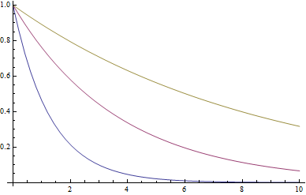
Let’s now calculate the correlation function $\left\langle S_{a}S_{a+2}\right\rangle$
Per definition
$$\left\langle S_{a}S_{a+2}\right\rangle =\frac{1}{Z}\sum_{S_{1},S_{2}, …,S_{N}}{{S_{a}S_{a+2}e}^{β\sum_{i=1}^{N−1}{J_{i}S_{i}S_{i+1}}}}$$
We use the trick
$$S_{a+1}S_{a+1}=S_{a+1}^{2}=1$$
$S_{a}S_{a+2}$=$S_{a}{∗1∗S}_{a+2}=S_{a}{S_{a+1}S_{a+1}S}_{a+2}$
$$\left\langle S_{a}S_{a+2}\right\rangle =\frac{1}{Z}\sum_{S_{1},S_{2}, …,S_{N}}{{S_{a}{S_{a+1}S_{a+1}S}_{a+2}e}^{β\sum_{i=1}^{N−1}{J_{i}S_{i}S_{i+1}}}}$$
$$=\frac{1}{Z}\frac{1}{β^{2}}\frac{∂^{2}Z}{∂J_{a}∂J_{a+1}}$$
$$=tanhβJ_{a}tanhβJ_{a+1}$$
For the special case $J_{a}=J_{a+1}=J$
T->0
we obtain
$$\left\langle S_{a}S_{a+2}\right\rangle ={\left(\tanh{βJ}\right)}^{2}$$
$$\left\langle S_{a}S_{a+b}\right\rangle$$
$\left\langle S_{a}S_{a+b}\right\rangle$=${\left(\tanh{βJ}\right)}^{b}$
$$b$$

Slide 8
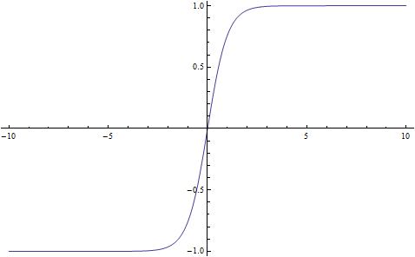
Correlation length
The last figure suggests:
Correlation between spins decays with increasing separation of the spin on a characteristic
T-dependent length scale we will call $ξ(T)$
$\left\langle S_{a}S_{a+b}\right\rangle$=${\left(\tanh{βJ}\right)}^{b}$
$${=e}^{\ln{{\left(\tanh{βJ}\right)}^{b}}}$$
$${=e}^{b ln{{\left(\tanh{βJ}\right)}^{}}}$$
$${=e}^{−{\frac{b}{ξ\left(T\right)}}}$$
$$tanh(x)$$
$$ξ\left(T\right)=\frac{1}{\left|\ln{\tanh{βJ}}\right|}$$
Note that $\tanh{βJ}<1$ and thus $\ln{\tanh{βJ<0}}$
Discussion
1
T->$∞ , β→0$
$\tanh{βJ}→$0
$$\left|\ln{\tanh{βJ}}\right|→∞$$
$$ξ\left(T→∞\right)→0$$
$$\tanh{βJ=\frac{e^{βJ}−e^{−βJ}}{e^{βJ}+e^{−βJ}}}=\frac{e^{βJ}−e^{−βJ}}{e^{βJ}\left(1+e^{−2βJ}\right)}=\frac{1−e^{−2βJ}}{\left(1+e^{−2βJ}\right)}$$
2
T->$0 , β→∞$
$$≈\frac{1−e^{−2βJ}}{\left(1+e^{−2βJ}\right)}≈{\left(1−e^{−2βJ}\right)}^{2}≈1−{2e}^{−2βJ}$$
$$\ln{\tanh{βJ≈\ln{(1−{2e}^{−2βJ})≈{2e}^{−2βJ}}}}$$
$$ξ\left(T→0\right)→\frac{1}{2}e^{2βJ}$$

Slide 9
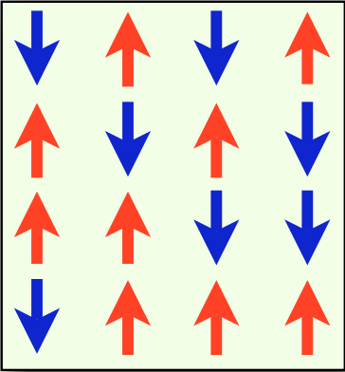
Significance of $ξ(T)$ is more transparent for higher spatial dimensions (2d, 3d) where $ξ(T)$ diverges at finite temperature T_{c}
At T_{c} fluctuations on all length scales including
length scale of the entire sample
$$ξ\left(T=T_{C}\right)→∞$$
W$ith ξ\left(T\right)$ also the susceptibility $χ\left(T\right)\text{diverges}$ because there is a general relation
between $χ\left(T\right)$ and the sum of spin-spin correlation functions $\left\langle S_{i}S_{j}\right\rangle$
$$χ\left(T\right)=\lim_{H→0}{\frac{∂M}{∂H} ∝}\lim_{H→0}\frac{∂}{∂H}\sum_{a}{\left\langle S_{a}\right\rangle }$$
$$∝\lim_{h→0}\frac{∂}{∂h}\sum_{a}{\frac{\sum_{S_{1},S_{2}…,S_{N}}{S_{a}e^{βJ \sum_{i}^{N}{S_{i}S_{i+1}}+ βh\sum_{i}^{N}{S_{i}}}}}{\sum_{S_{1},S_{2}…,S_{N}}{e^{βJ \sum_{i}^{N}{S_{i}S_{i+1}}+βh\sum_{i}^{N}{S_{i}}}}}}$$
$$=\lim_{h→0}\sum_{a}{\frac{\sum_{S_{1},S_{2}…,S_{N}}{S_{a}\left(β\sum_{i}^{N}{S_{i}}\right)e^{βJ \sum_{i}^{N}{S_{i}S_{i+1}}+βh\sum_{i}^{N}{S_{i}}}Z−\left(\sum_{S_{1},S_{2}…,S_{N}}{\left(β\sum_{i}^{N}{S_{i}}\right)e^{βJ \sum_{i}^{N}{S_{i}S_{i+1}}+βh\sum_{i}^{N}{S_{i}}}}\right)\left(\sum_{S_{1},S_{2}…,S_{N}}{S_{a}e^{βJ \sum_{i}^{N}{S_{i}S_{i+1}}+ βh\sum_{i}^{N}{S_{i}}}}\right)}}{Z^{2}}}$$
$$=\lim_{h→0}\sum_{a}{\frac{\sum_{S_{1},S_{2}…,S_{N}}{S_{a}\left(β\sum_{i}^{N}{S_{i}}\right)e^{βJ \sum_{i}^{N}{S_{i}S_{i+1}}+βh\sum_{i}^{N}{S_{i}}}}}{Z^{}}−\frac{\left(\sum_{S_{1},S_{2}…,S_{N}}{\left(β\sum_{i}^{N}{S_{i}}\right)e^{βJ \sum_{i}^{N}{S_{i}S_{i+1}}+βh\sum_{i}^{N}{S_{i}}}}\right)\left(\sum_{S_{1},S_{2}…,S_{N}}{S_{a}e^{βJ \sum_{i}^{N}{S_{i}S_{i+1}}+ βh\sum_{i}^{N}{S_{i}}}}\right)}{Z^{2}}}$$

Slide 10
$$=\lim_{h→0}\sum_{a}{\frac{\sum_{S_{1},S_{2}…,S_{N}}{S_{a}\left(β\sum_{i}^{N}{S_{i}}\right)e^{βJ \sum_{i}^{N}{S_{i}S_{i+1}}+βh\sum_{i}^{N}{S_{i}}}}}{Z^{}}−\frac{\left(\sum_{S_{1},S_{2}…,S_{N}}{\left(β\sum_{i}^{N}{S_{i}}\right)e^{βJ \sum_{i}^{N}{S_{i}S_{i+1}}+βh\sum_{i}^{N}{S_{i}}}}\right)\left(\sum_{S_{1},S_{2}…,S_{N}}{S_{a}e^{βJ \sum_{i}^{N}{S_{i}S_{i+1}}+ βh\sum_{i}^{N}{S_{i}}}}\right)}{Z^{} ∗ Z}}$$
$∝\left\langle \sum_{i}^{N}{S_{i}}\right\rangle$ $∝ M$
0
for h->$0$
$\left\langle S_{a}\right\rangle$->0
for h->$0$
No long range order for the Ising chain
$$χ\left(T\right)=const\frac{β}{N}\sum_{a,i}{\left\langle S_{a}S_{i}\right\rangle }$$
with const=$\frac{N}{V}{\left(gμ_{B}\right)}^{2}μ_{0}\frac{J(J+1)}{3}$
Let’s see how this expression reproduces paramagnetic susceptibility in the limit J=0
$$\frac{1}{N}\sum_{a,i}{\left\langle S_{a}S_{i}\right\rangle }=\frac{1}{N}\sum_{a=i}{\left\langle S_{a}S_{i}\right\rangle }+\frac{1}{N}\sum_{a}{\sum_{i≠a}{\left\langle S_{a}S_{i}\right\rangle }}$$
$$=1+\frac{1}{N}\sum_{a}{2\sum_{i^{}=1}^{N}{\left\langle S_{a}S_{a+j}\right\rangle }}$$
$$=1+2\sum_{j=1}^{N}{{\left(\tanh{βJ} \right)}^{j} }$$
The 2 originates from the fact that
terms such as
appear twice in the a,i-double sum
$\left\langle S_{1}S_{2}\right\rangle$=$\left\langle S_{2}S_{1}\right\rangle$

Slide 11
Let’s have a look to the limit of a long (relative to the correlation length) Ising chain
$$N→∞$$
$$\frac{1}{N}\sum_{a,i}{\left\langle S_{a}S_{i}\right\rangle }→$$
$$1+2\sum_{j=1}^{∞}{{\left(\tanh{βJ} \right)}^{j} }=1−2+2\sum_{j=0}^{∞}{{\left(\tanh{βJ} \right)}^{j} }$$
$$=1+2\left(\frac{1}{1−\tanh{βJ}}−1\right)$$
$$=1+2\left(\frac{\tanh{βJ}}{1−\tanh{βJ}}\right)$$
$$=1+2\left(\frac{e^{βJ}−e^{−βJ}}{\left(e^{βJ}+e^{−βJ}\right)\left(1−\frac{e^{βJ}−e^{−βJ}}{e^{βJ}+e^{−βJ}}\right)}\right)$$
$$=1+2\left(\frac{e^{βJ}−e^{−βJ}}{\left(e^{βJ}+e^{−βJ}−e^{βJ}+e^{−βJ}\right)}\right)$$
$$=1+\left(e^{2βJ}−1\right)$$
$$χ\left(T\right)=const\frac{β}{N}\sum_{a,i}{\left\langle S_{a}S_{i}\right\rangle }$$
$$=const\frac{β}{N}e^{2βJ}$$
For J=0 this indeed reduced to the Curie-law of interaction free paramagnets
$$χ\left(T\right)∞\frac{1}{T}$$

Slide 12
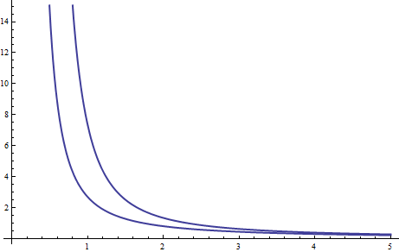
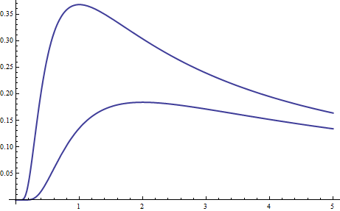
For J0 it is interesting to discuss the cases of ferro and antiferromagnetic coupling
J>0
ferromagnetic coupling
$$χ\left(T\right)$$
$$χ∝\frac{e^{\frac{2J}{k_{B}T}}}{T}$$
J
T
J<0
antiferromagnetic coupling
J=-1/2
$$χ\left(T\right)$$
$$χ∝\frac{e^{−\frac{2\left|J\right|}{k_{B}T}}}{T}$$
J=-1
T

